Slide 1
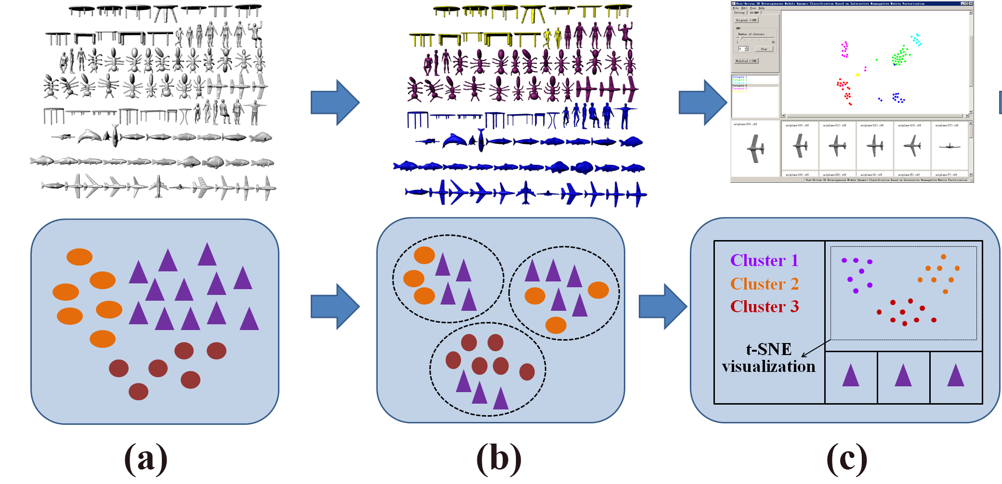
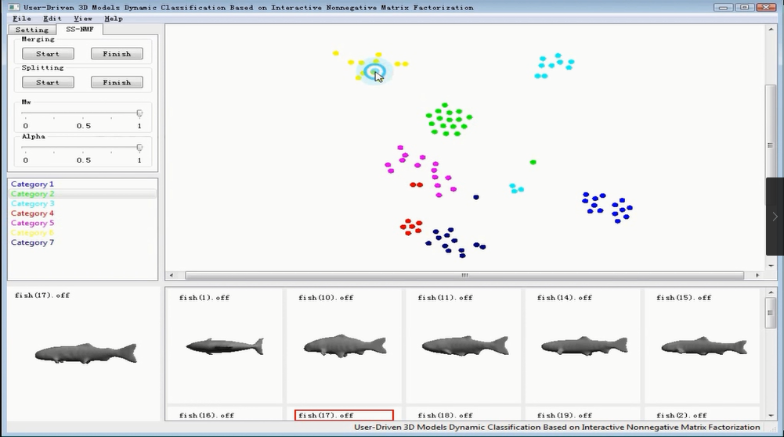
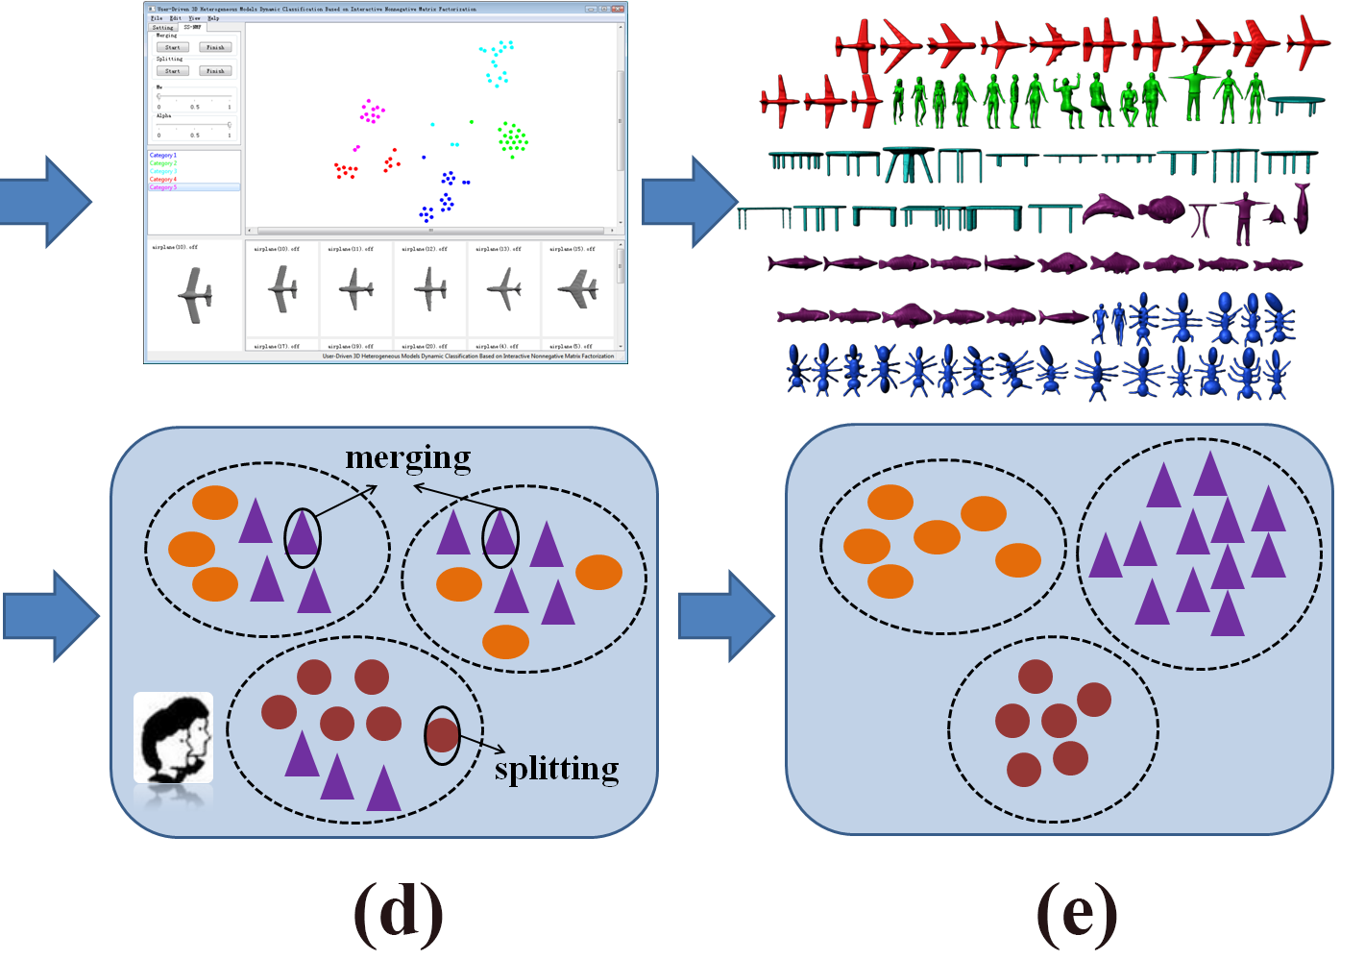
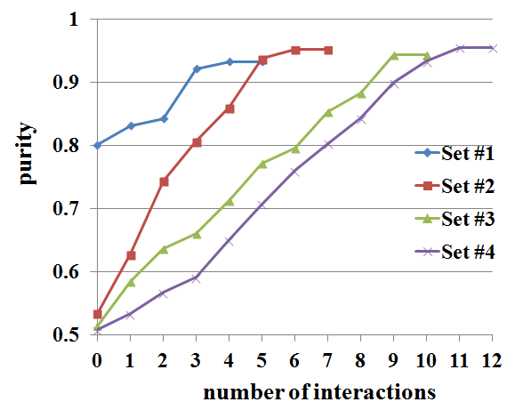
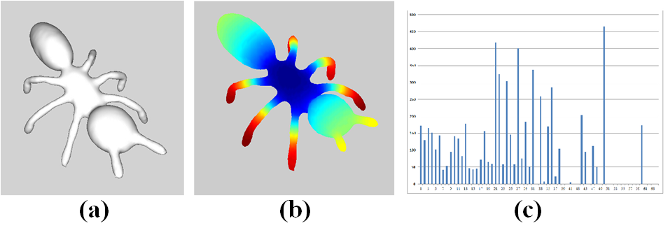
User-Driven 3D Models Dynamic Classification Based on Interactive Nonnegative Matrix Factorization
First-Name Yu First-Name Sun
zhangsan@123.edu.cn lisi@123.edu.cn
*** Lab, ***** University, China
【OVERVIEW】
【INTERACTIVE INTERFACE】
【EXPERIMENT RESULTS】
(a) The input model set. (b) pre-classification of the model set based on NMF. (c) Visualization based on improved t-SNE. (d) Dynamic classification of the model set based on interactive NMF. (e) Final classificaiton result.
Cluster purity influenced by interaction times
【FEATURE ENCODING】
【References】
[1]. XXXXX
[2]. XXXXX
[3]. XXXXX
This work was supported by the National Natural Science Foundation China (No. XXX)….
(a)The input model. (b) HKS Feature description. (c)Bag of features.
【Acknowledgments】

